Slide 1
Virtual Memory Session 11
Course COMP6153
Effective Period : September 2018

Slide 2
Sub Topics
Paging
Segmentation

Slide 3
These slides have been adapted from: Stallings, W. (2011). Operating Systems: Internals and Design Principles. 8^{th.} ISBN: 978-0-13-380591-8 Chapter 8
Acknowledgement

Slide 4
Learning Objectives
At the end of this lecture, students are able to:
LO1 : Explain how Paging is implemented in Modern Operating System
LO2: Explain the purpose of paging
LO3 : Apply different strategies of page Replacement Algorithm

Slide 5
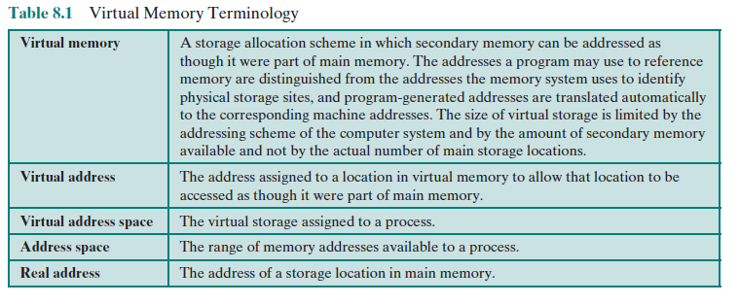
Virtual Memory Terminology

Slide 6
Real vs. Virtual Memory
Real memory
main memory, the actual RAM
Virtual memory
memory on disk
allows for effective multiprogramming and relieves the user of tight constraints of main memory

Slide 7
Support needed for Virtual Memory
For virtual memory to be practical and effective:
hardware must support paging and segmentation
operating system must include software for managing the movement of pages and/or segments between secondary memory and main memory

Slide 8
Paging
The term virtual memory is usually associated with systems that employ paging
Use of paging to achieve virtual memory was first reported for the Atlas computer
Each process has its own page table
each page table entry contains the frame number of the corresponding page in main memory
Entry k contains the frame # of page k (if page k is in memory)

Slide 9
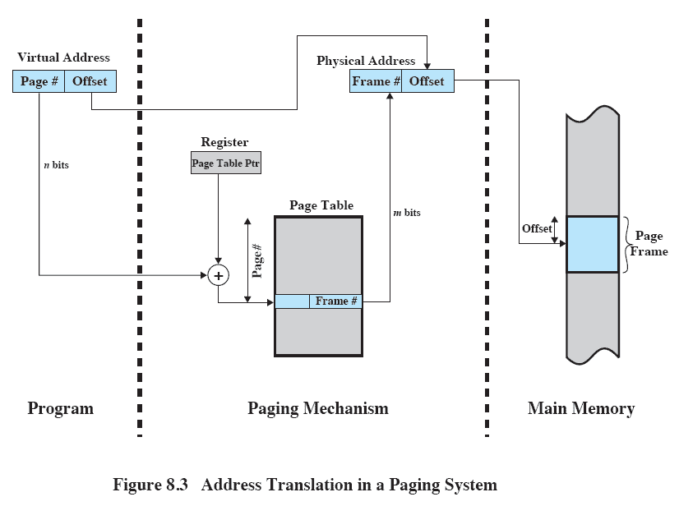
Address Translation

Slide 10
Page Table
Simple page table: one PageTable per process
Size is a problem – for 32-bit addresses, half for OS, half for user space, the number of pages in a user process is 2³²/pagesize. For pagesize = 2¹⁰, page table would have 2²² entries. PER PROCESS!
Solution? Page the page table!

Slide 11
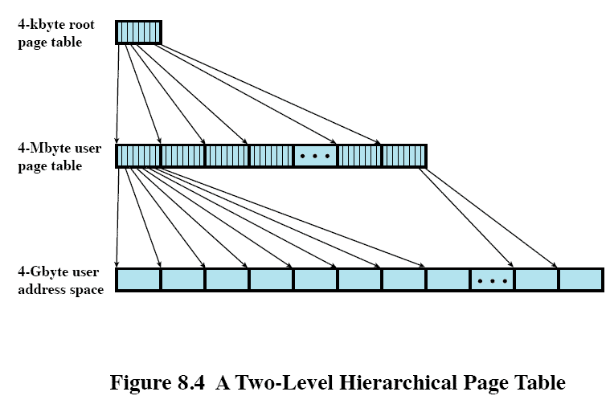
Hierarchical Page Table structure

Slide 12
Inverted Page Table structure(1)
Simple page tables, hierarchical page tables occupy a lot of space: each process has its own PT, size of each PT is proportional to size of virtual address space.
Another approach: one page table maps everything in memory. Page table size is fixed.

Slide 13
Inverted Page Table structure(2)
Page number portion of a virtual address is mapped into a hash value
hash value points to inverted page table
Fixed proportion of real memory is required for the tables regardless of the number of processes or virtual pages supported
Structure is called inverted because it indexes page table entries by frame number rather than by virtual page number

Slide 14
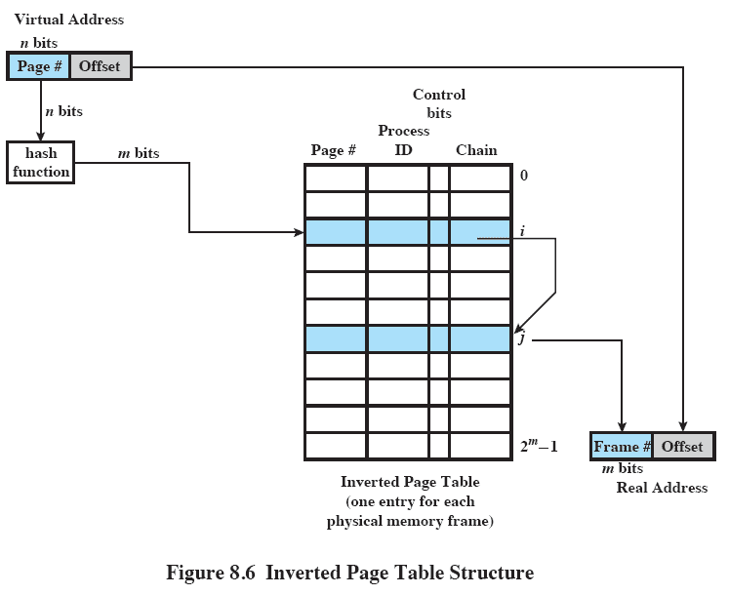
Inverted Page Table structure(3)

Slide 15
Transaction Lookaside Buffer(TLB)
Each virtual memory reference can cause two physical memory accesses:
one to fetch the page table entry
one to fetch the data (or the next instruction)
To overcome the effect of doubling the memory access time, most virtual memory schemes make use of a special high-speed cache called a translation lookaside buffer

Slide 16
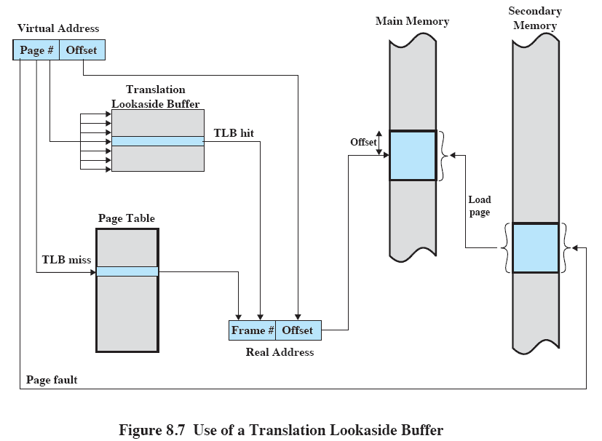
Use of TLB

Slide 17
Page Size
The smaller the page size, the lesser the amount of internal fragmentation
however, more pages are required per process
more pages per process means larger page tables
for large programs in a heavily multiprogrammed environment some portion of the page tables of active processes must be in virtual memory instead of main memory
the physical characteristics of most secondary-memory devices favor a larger page size for more efficient block transfer of data

Slide 18
Page Size
The design issue of page size is related to the size of physical main memory and program size
main memory is getting larger and address space used by applications is also growing
most obvious on personal computers where applications are becoming increasingly complex

Slide 19
Segmentation
Advantages:
simplifies handling of growing data structures
allows programs to be altered and recompiled independently
lends itself to sharing data among processes
lends itself to protection
Segmentation allows the programmer to view memory as consisting of multiple address spaces or segments

Slide 20
Segment Organization
Each segment table entry contains the starting address of the corresponding segment in main memory and the length of the segment
A bit is needed to determine if the segment is already in main memory
Another bit is needed to determine if the segment has been modified since it was loaded in main memory

Slide 21
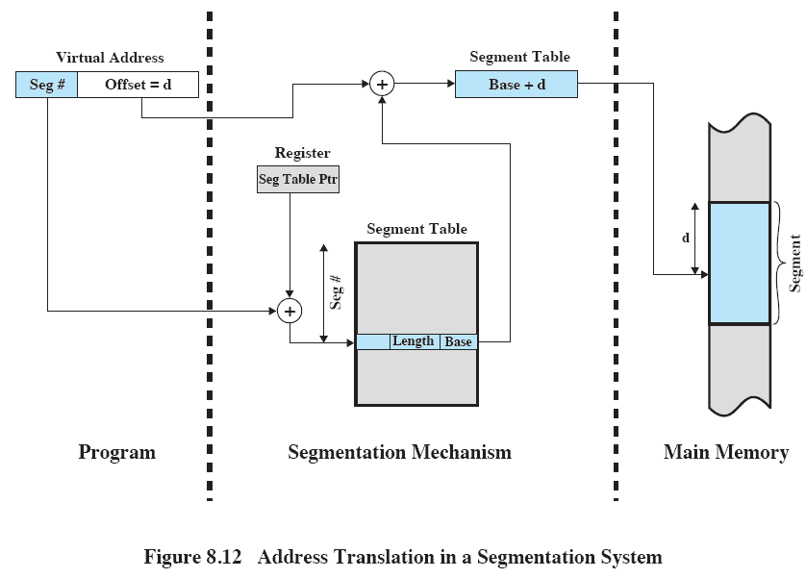
Address Translation

Slide 22
Combined Paging and Segmentation
In a combined paging/segmentation system a user’s address space is broken up into a number of segments. Each segment is broken up into a number of fixed-sized pages which are equal in length to a main memory frame
Segmentation is visible to the programmer
Paging is transparent to the programmer

Slide 23
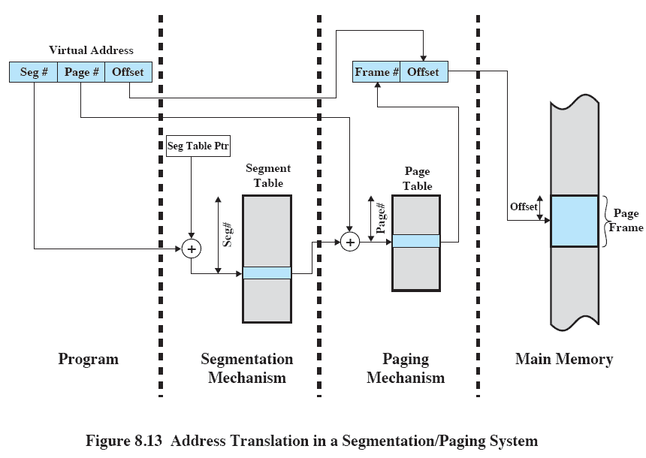
Address Translation

Slide 24
Replacement Policy
Deals with the selection of a page in main memory to be replaced when a new page must be brought in
objective is that the page that is removed be the page least likely to be referenced in the near future
The more elaborate the replacement policy the greater the hardware and software overhead to implement it

Slide 25
Basic Algorithm
Algorithms used for the selection of a page to replace:
Optimal
Least recently used (LRU)
First-in-first-out (FIFO)
Clock

Slide 26
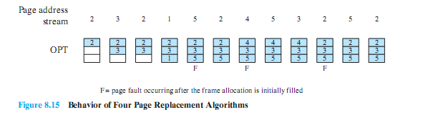
Optimal Policy
Selects the page for which the time to the next reference is the longest
Produces three page faults after the frame allocation has been filled (in addition to 1st 3 faults)

Slide 27
Least Recently Used (LRU)
Replaces the page that has not been referenced for the longest time
By the principle of locality, this should be the page least likely to be referenced in the near future
Difficult to implement
one approach is to tag each page with the time of last reference
this requires a great deal of overhead

Slide 28
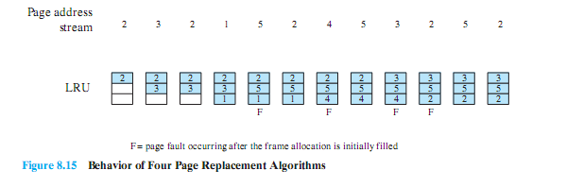
LRU Example

Slide 29
First-in-First-out (FIFO)
Treats page frames allocated to a process as a circular buffer
Pages are removed in round-robin style
simple replacement policy to implement
Page that has been in memory the longest is replaced

Slide 30
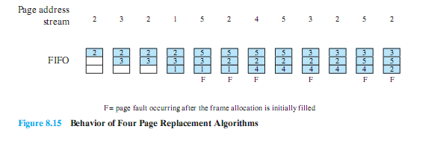
FIFO Example

Slide 31
Clock Policy
Requires the association of an additional bit with each frame
referred to as the use bit
When a page is first loaded in memory or referenced, the use bit is set to 1
The set of frames is considered to be a circular buffer
Any frame with a use bit of 1 is passed over by the algorithm
Page frames visualized as laid out in a circle

Slide 32
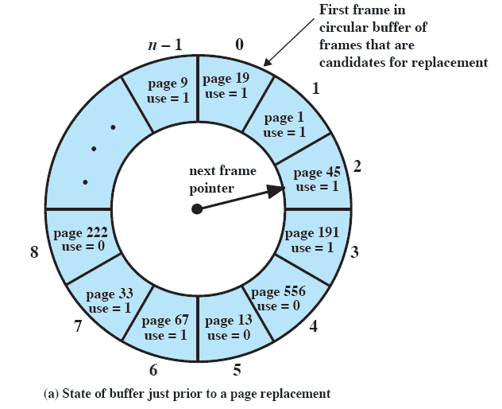
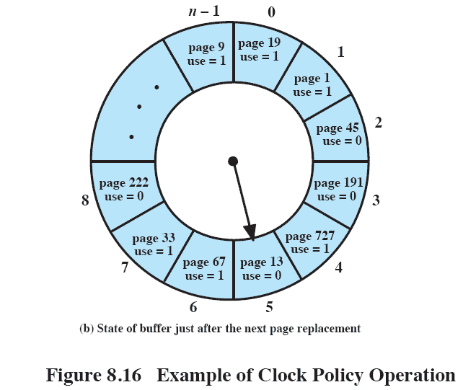
Clock Policy

Slide 33

Clock Policy
Page Address Stream

Slide 34
References
Stallings, W. (2014). Operating Systems: Internals and Design Principles. 8^{th.} ISBN: 978-0-13-380591-8

